Slide 1

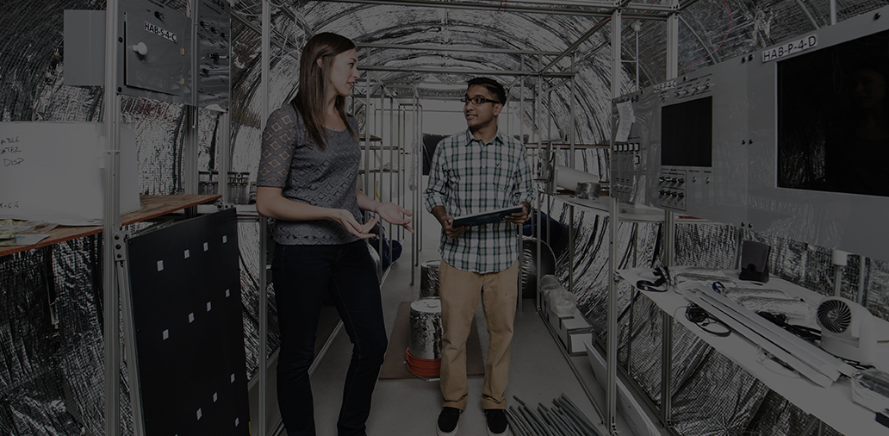
Title: Are Clustering Algorithms
Capable Credit Score Classifiers
Unsupervised Learning Final Project
Todd Gardiner
MSDS Candidate
University of Colorado Boulder
https://www.kaggle.com/code/toddgardiner/unsupervised-final-creditscoring/

Slide 2
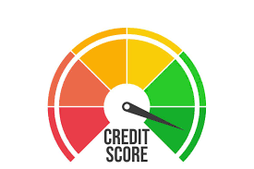
Background:
Credit Worthiness Applications are Typical
Usually this is a Supervised Learning Activity
Labeled Training Datasets
Large Datasets are Available to Lenders
Limitations
New Borrowers have no History
Supervised Models Take a Long Time To Set Up
https://www.kaggle.com/code/toddgardiner/unsupervised-final-creditscoring/

Slide 3

Can a Clustering Algorithm
Classify Credit Worthiness?
To Address Cases Without History
To Increase Model Training Speed
We Will Explore the Capability of Clustering Algorithms on a DIFFICULT Classification Problem!
https://www.kaggle.com/code/toddgardiner/unsupervised-final-creditscoring/

Slide 4
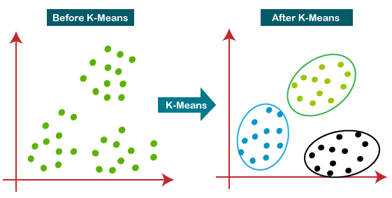
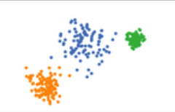
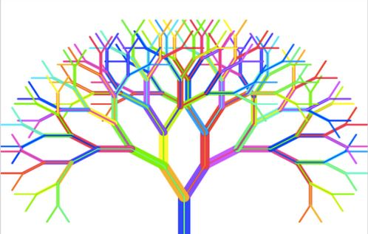
Objective and Steps:
KMeans
Prove Efficacy of Clustering Classifiers
Compare results to Random Forest Classifier
Load the Data and Inspect
Data Preprocessing
Clustering Algorithm – KMeans
Clustering Algorithm - Agglomerative
Supervised Algorithm – Random Forest
Conclusion
Agglomerative
Random Forest
https://www.kaggle.com/code/toddgardiner/unsupervised-final-creditscoring/

Slide 5
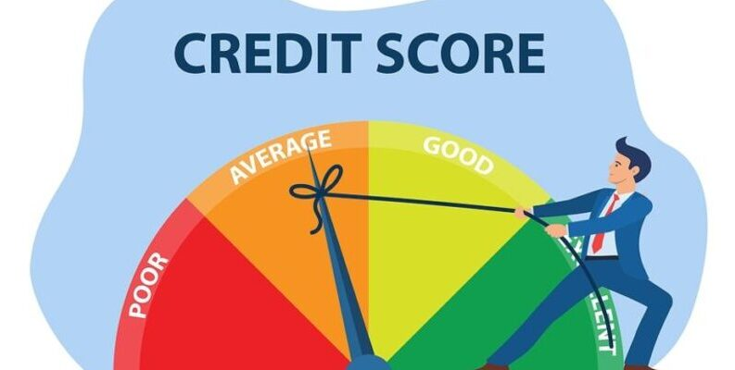
Dataset: Credit Score Classification Clean
Location: https://www.kaggle.com/datasets/clkmuhammed/creditscoreclassification
Usability Rating of 6.47 (Leading classifiers are unable to eclipse 90% accuracy)
Statistics:
100,000 observations (rows of data)
28 Columns of data (2 ID, 4 Personal, 17 Numeric Financial, 5 Categorical)
Highly Unbalanced Dataset
Selected for BOTH: Difficulty and Real-World Applicability
https://www.kaggle.com/code/toddgardiner/unsupervised-final-creditscoring/

Slide 6
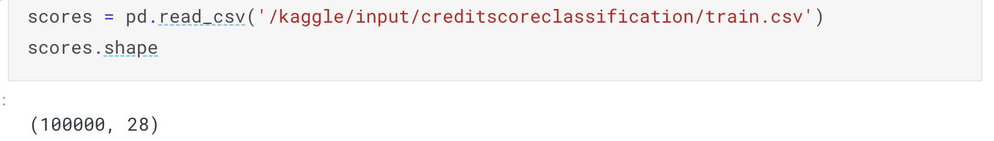
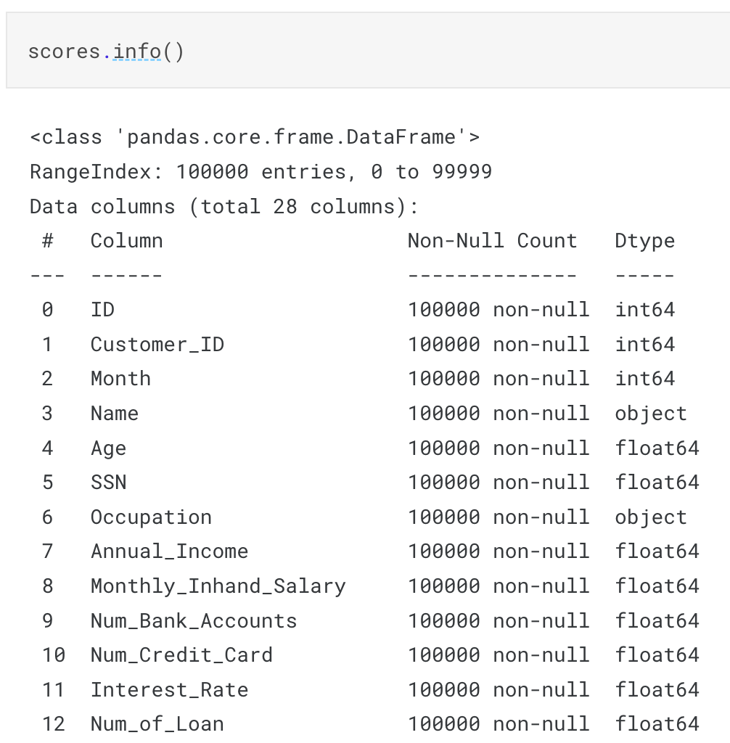
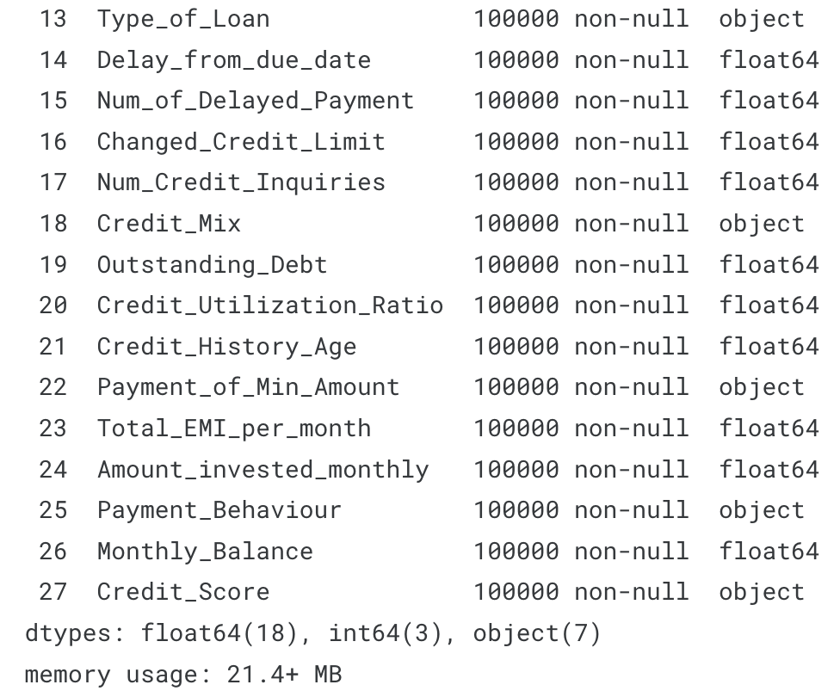
Load The Data:
Pandas read_csv() & shape
Read the Data into the work-space
Show row and column counts
Pandas Info()
Proves No Null Values
Delineates Categorical/Numeric
Shows Size of Dataset (21 MB)
Pandas describe() (not shown)
First look into the data.
Get a feel for the mean, range, quantiles of the data
https://www.kaggle.com/code/toddgardiner/unsupervised-final-creditscoring/

Slide 7
Make This Harder:
Remove all Categorical Data
Results in 19 columns of Data
Best case is reduced!
Now ~75% Classification
We’ll use 75% for Metrics
https://www.kaggle.com/code/toddgardiner/unsupervised-final-creditscoring/

Slide 8
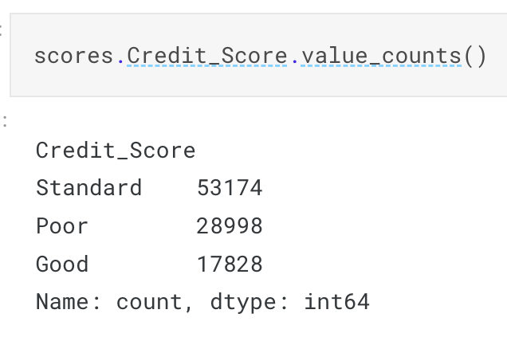
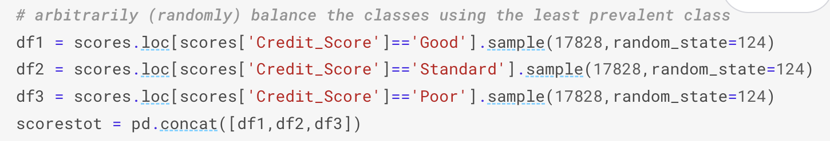
Data Preprocessing:
Balanced Dataset? No!
100,000 Records/Observations with Unbalanced Classes
Resample the Data to Balance Classes
https://www.kaggle.com/code/toddgardiner/unsupervised-final-creditscoring/

Slide 9
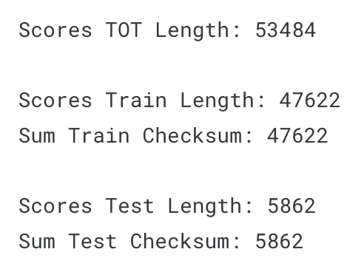
Data Preprocessing:
Balanced Dataset. YES
Make Training and Testing Set
53,484 Records After Balancing
Training Set: (Sample Balanced Set)
15874/17828 (Each of Three Classes)
47622 Observations
Test Set:
Remainder of Observations
Check to see that the records add up.
https://www.kaggle.com/code/toddgardiner/unsupervised-final-creditscoring/

Slide 10
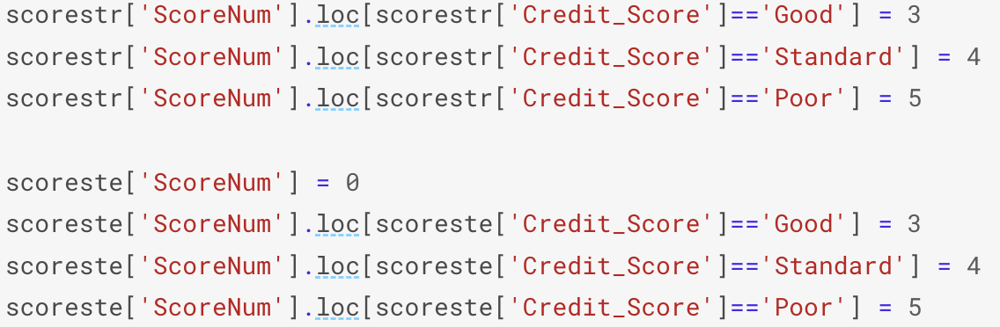
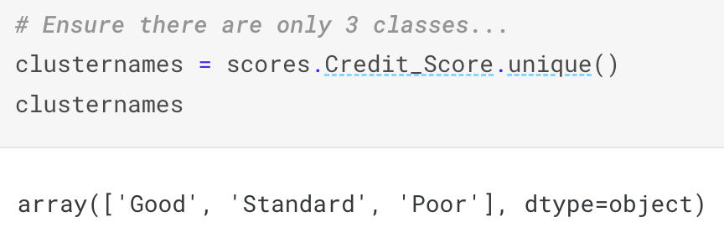
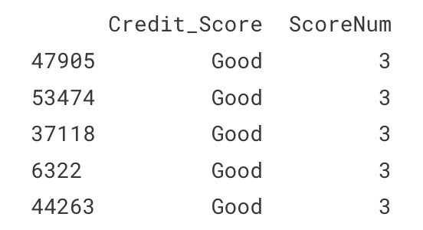
Data Preprocessing:
Switch Target Variable to Numeric Classes
We have 3 Target Classes:
Clustering will Arbitrarily Assign Numeric Classes
(0, 1, 2)
So we need the target as Numeric to match them.
(3, 4, 5) (Apply to Train and Test Sets)
Visually Check Results.
https://www.kaggle.com/code/toddgardiner/unsupervised-final-creditscoring/

Slide 11

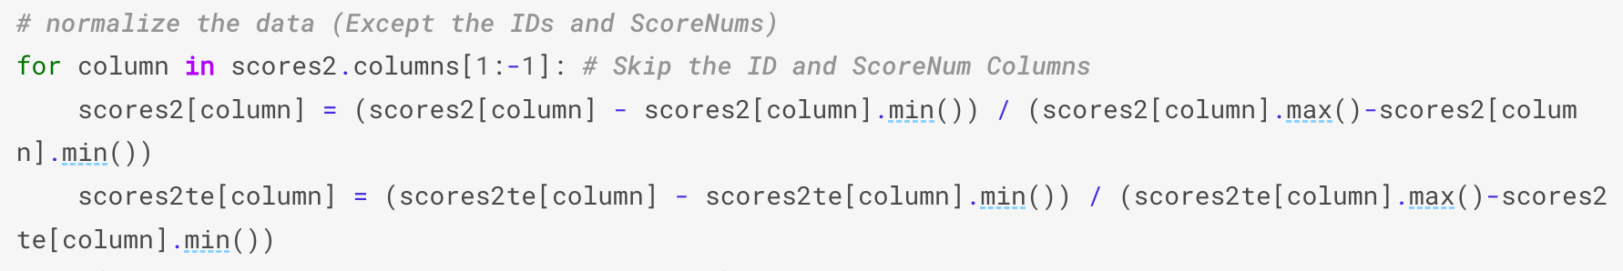
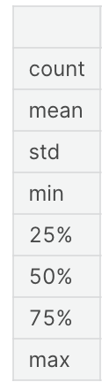
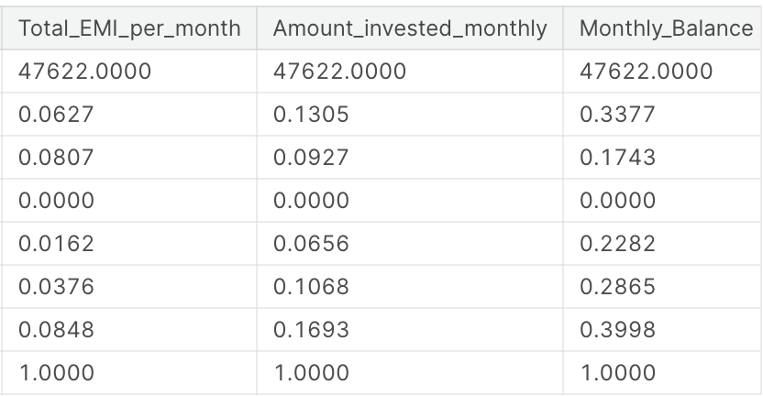
Make Copies
Data Preprocessing:
Normalized Data & Original Data
Clustering Algorithms Measure Distance.
Often Work Best on Normalized Data.
(0 to 1) (Z-Scored) (-1 to 1)
I chose (0 to 1):
(Value – Column Min) / (Column Max – Column Min)
Visually Inspect with Pandas describe()
Normalize a Copy
Inspect the Copy
https://www.kaggle.com/code/toddgardiner/unsupervised-final-creditscoring/

Slide 12
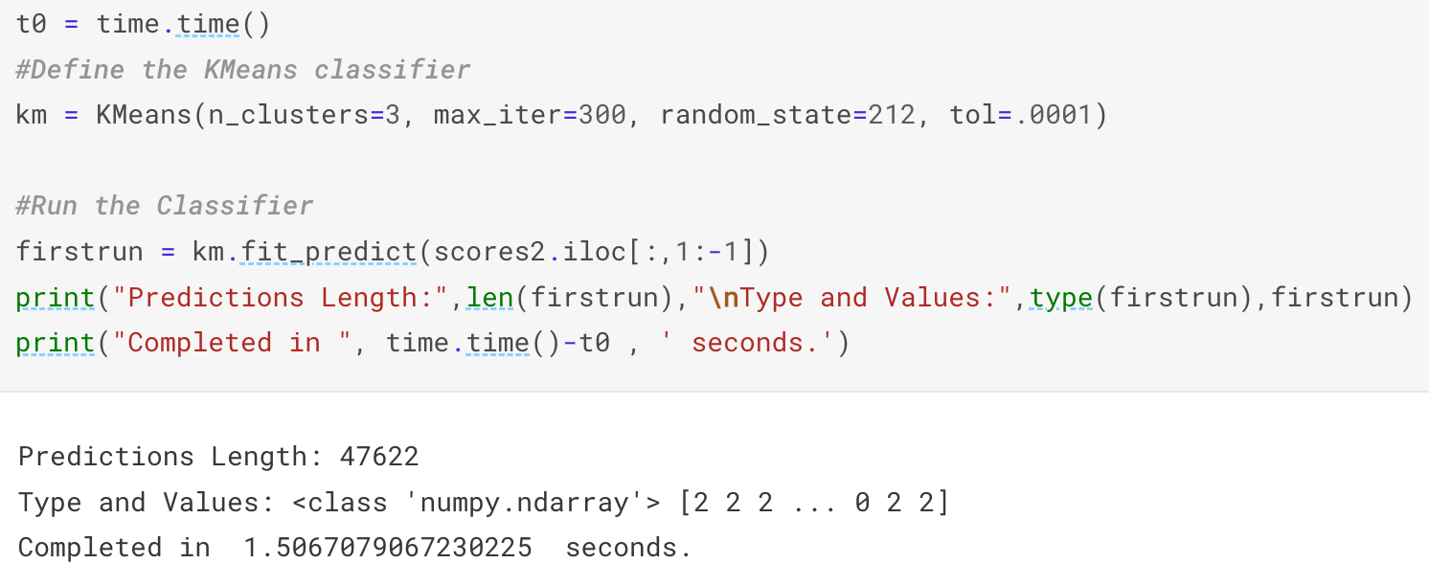
Clustering Attempt 1: KMeans
Simple: 2 lines of Code (3 Classes = 3 Clusters)
Fast: 1.51 Seconds
Run on Normalized Data
https://www.kaggle.com/code/toddgardiner/unsupervised-final-creditscoring/

Slide 13
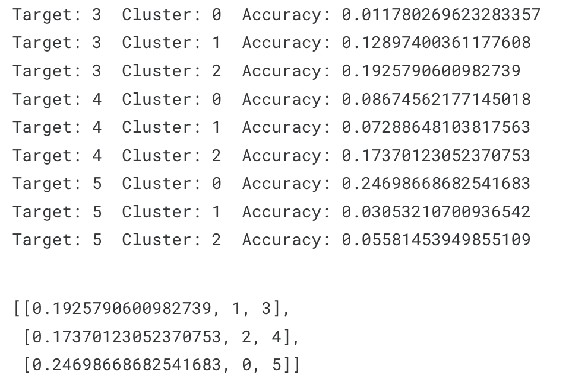
Clustering Attempt 1: KMeans
Result is Arbitrarily Numbered Clusters.
We need to match the clusters to our target classes.
Easy Jobs Are Easy!
This is a Difficult Task.
We’ll Have To Hand Select 1
https://www.kaggle.com/code/toddgardiner/unsupervised-final-creditscoring/

Slide 14
Clustering Attempt 1: KMeans
Result is Arbitrarily Numbered Clusters.
We need to match the clusters to our classes.
Easy Jobs Are Easy!
This is a Difficult Task.
We’ll Have To Hand Select 1
https://www.kaggle.com/code/toddgardiner/unsupervised-final-creditscoring/

Slide 15
Clustering Attempt 1: KMeans
Result is Arbitrarily Numbered Clusters.
We need to match the clusters to our classes.
Easy Jobs Are Easy!
This is a Difficult Task.
We’ll Have To Hand Select 1
https://www.kaggle.com/code/toddgardiner/unsupervised-final-creditscoring/

Slide 16
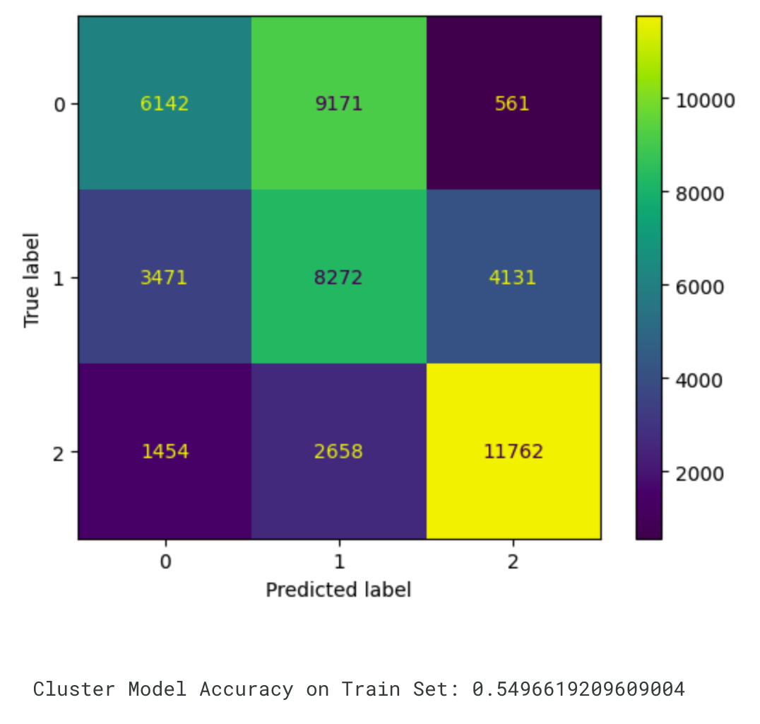
Clustering Attempt 1: KMeans
Results on Training Data:
https://www.kaggle.com/code/toddgardiner/unsupervised-final-creditscoring/

Slide 17
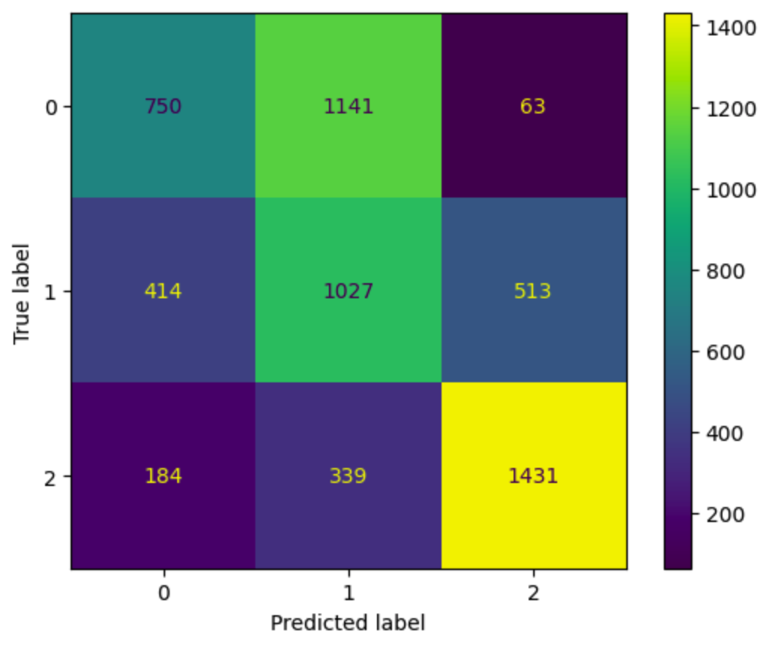
Clustering Attempt 1: KMeans
Results on Training Data:
Results on Testing Data:
Model Generalized Well (.002 loss)
Capable of Making Predictions
~55% accuracy on stripped down data
55% / 75% = 73% Capable
https://www.kaggle.com/code/toddgardiner/unsupervised-final-creditscoring/

Slide 18
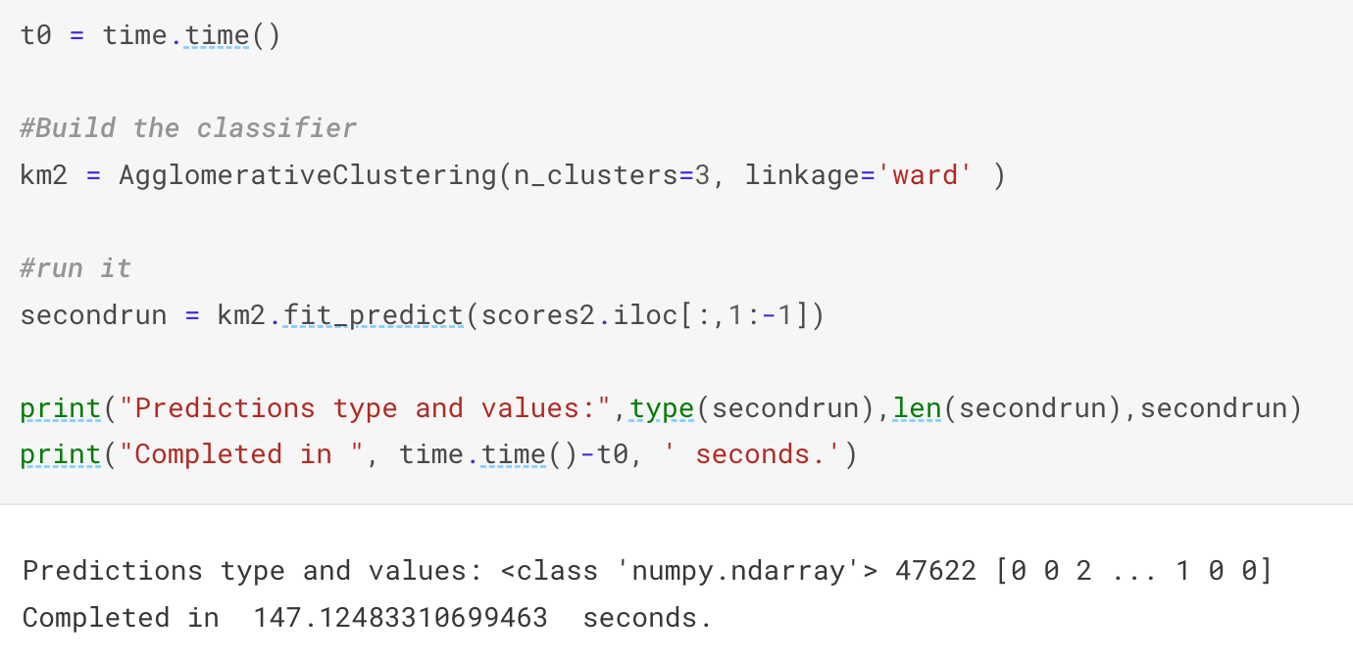
Clustering Attempt 2: Agglomerative
Simple (2 lines of code)
More Options: ward, singular, average, & complete
Slower (2.5 Minutes)
https://www.kaggle.com/code/toddgardiner/unsupervised-final-creditscoring/

Slide 19
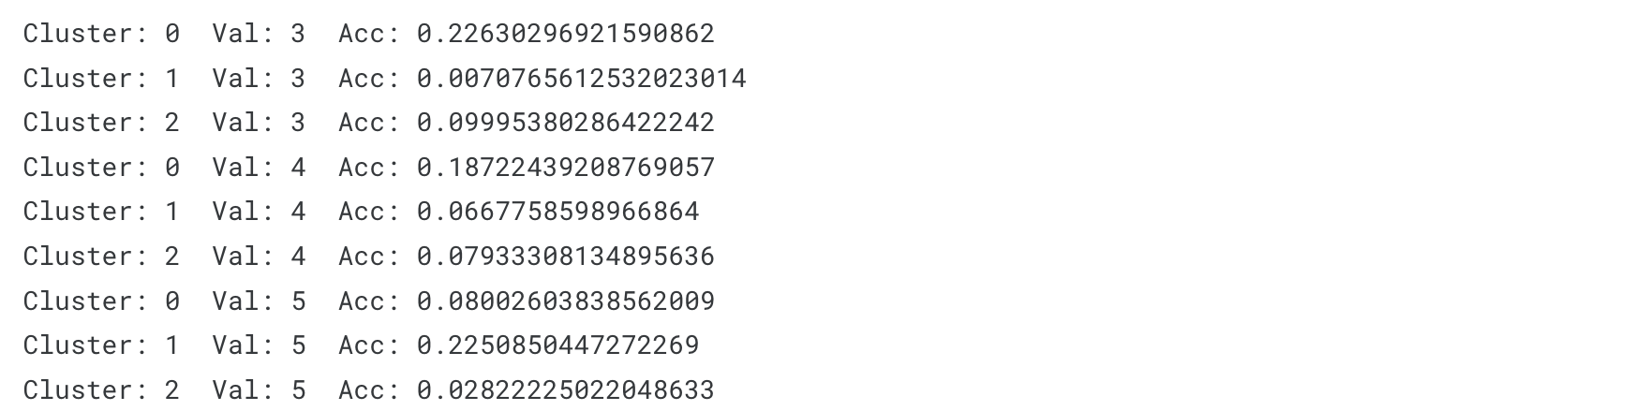
Clustering Attempt 2: Agglomerative
Again, Clustering Yields Arbitrary Clusters.
Clusters must be Assigned to Classes after the fact.
Cycle through permutations and pick the best outcomes.
28% 30%
https://www.kaggle.com/code/toddgardiner/unsupervised-final-creditscoring/

Slide 20
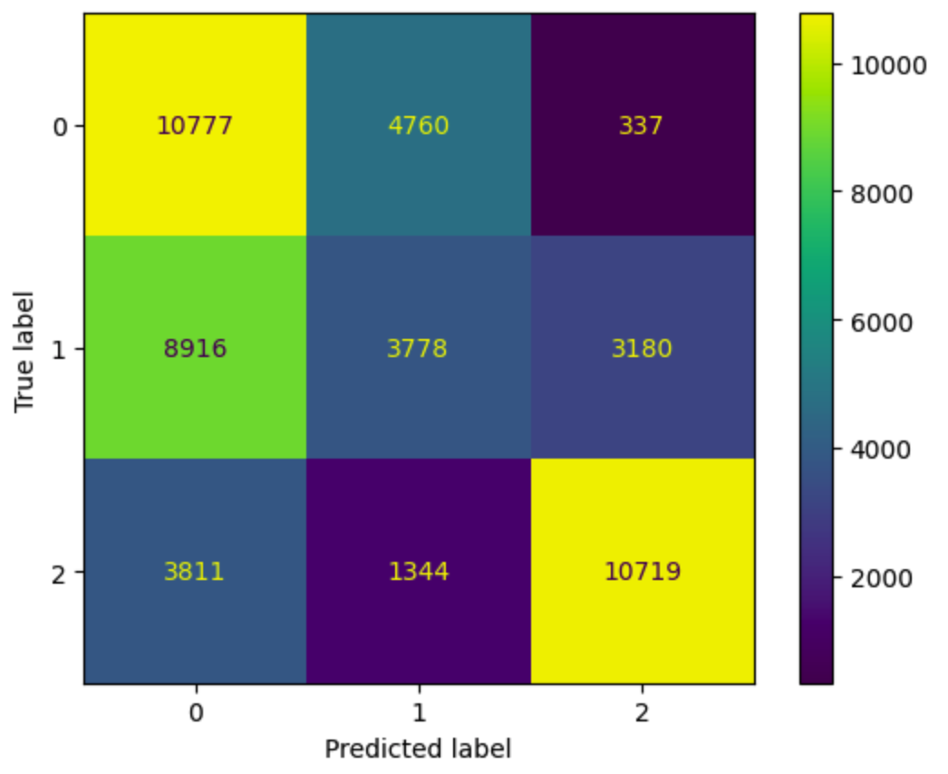
Clustering Attempt 2: Agglomerative
Training Set Results:
Unable to Predict By Construction
Useful on Seen Data Only
Many Clustering Algorithms Unable (Agglomerative, DBSCAN, HDBSCAN, etc.)
Still a Good Classifier on Seen Data
53% / 75% = 70% Capable
https://www.kaggle.com/code/toddgardiner/unsupervised-final-creditscoring/

Slide 21


Supervised Comparison: Random Forest
Multi-Step: (Tuning, Build, Predict)
Complex: (Millions of Permutations to Tune)
Slowest Process (Over 90 Minutes)
https://www.kaggle.com/code/toddgardiner/unsupervised-final-creditscoring/

Slide 22
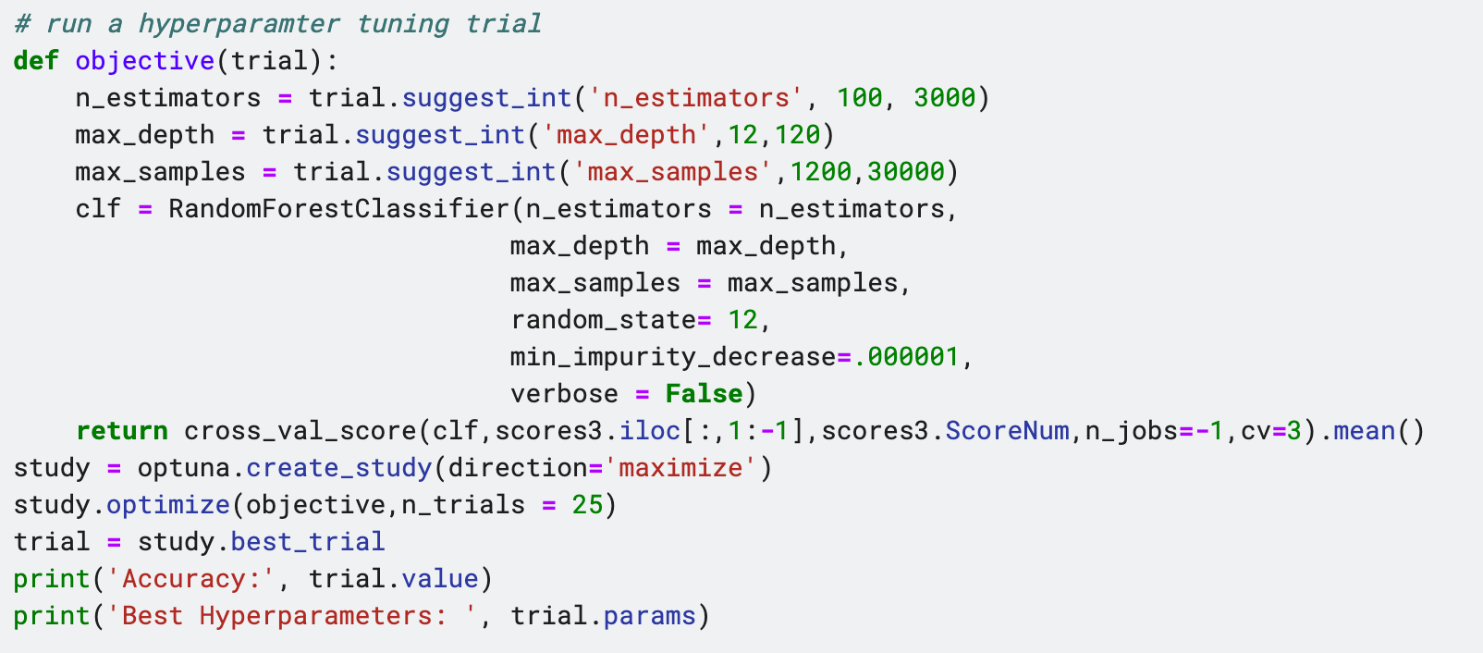
Supervised Comparison: Random Forest
Tuning (With Optuna)
https://www.kaggle.com/code/toddgardiner/unsupervised-final-creditscoring/

Slide 23
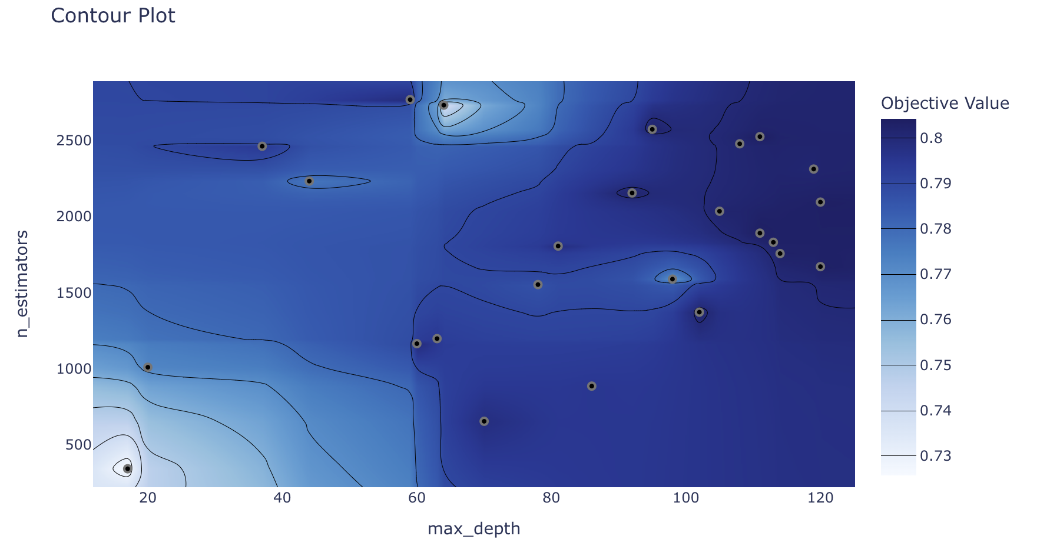
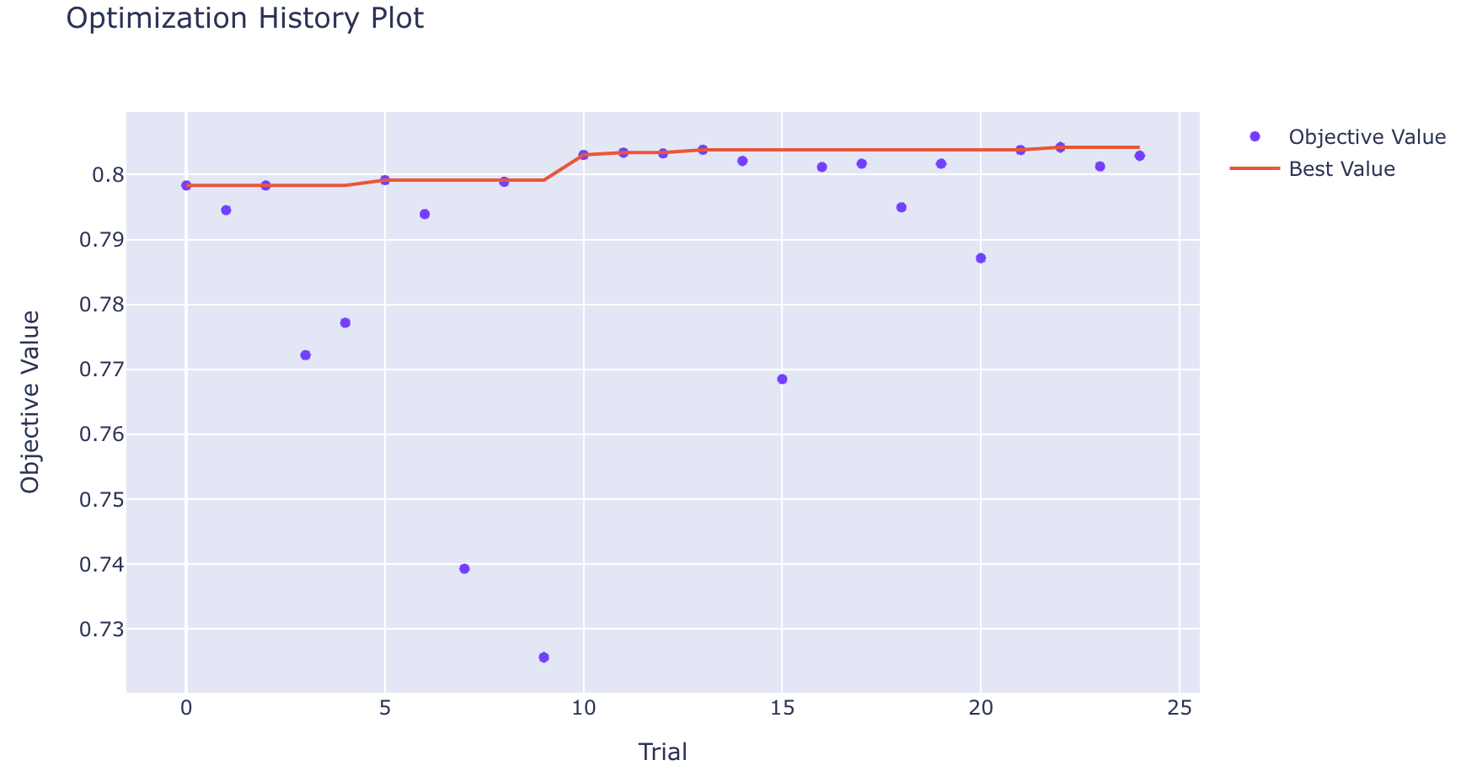
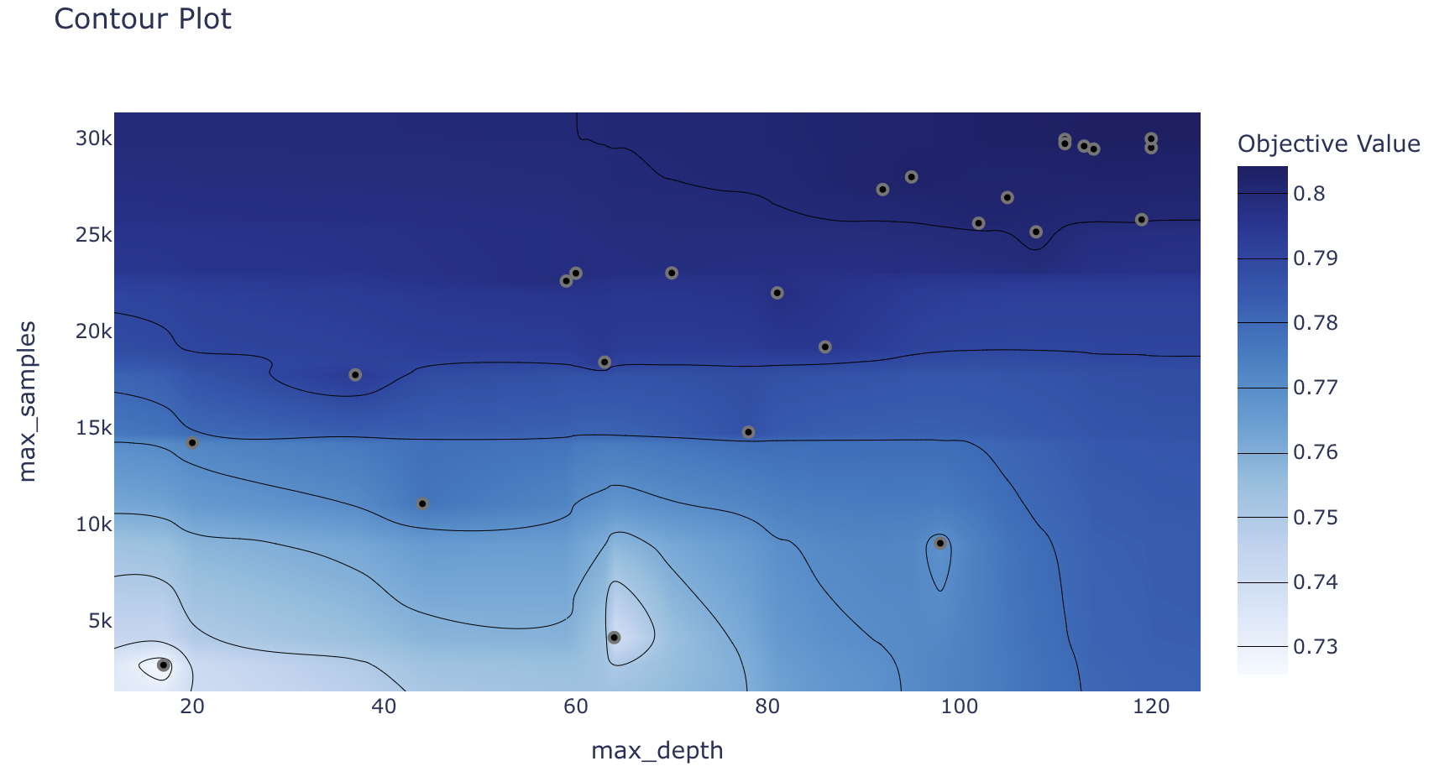
Supervised Comparison: Random Forest
Tuning (90 Minutes) Optuna Visualizations of Process
https://www.kaggle.com/code/toddgardiner/unsupervised-final-creditscoring/

Slide 24
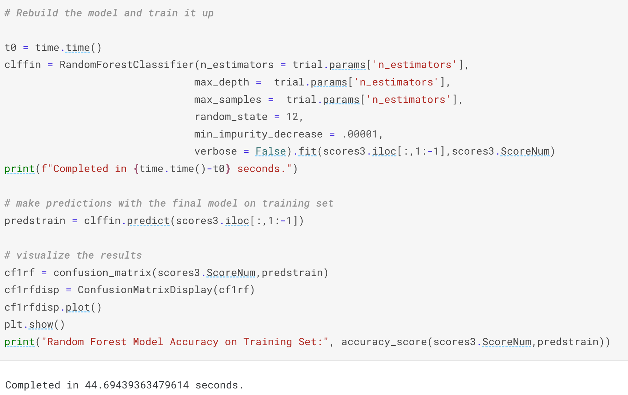
Supervised Comparison: Random Forest
Tuning (>90 Min)
Build Classifier (<1 Min)
https://www.kaggle.com/code/toddgardiner/unsupervised-final-creditscoring/

Slide 25
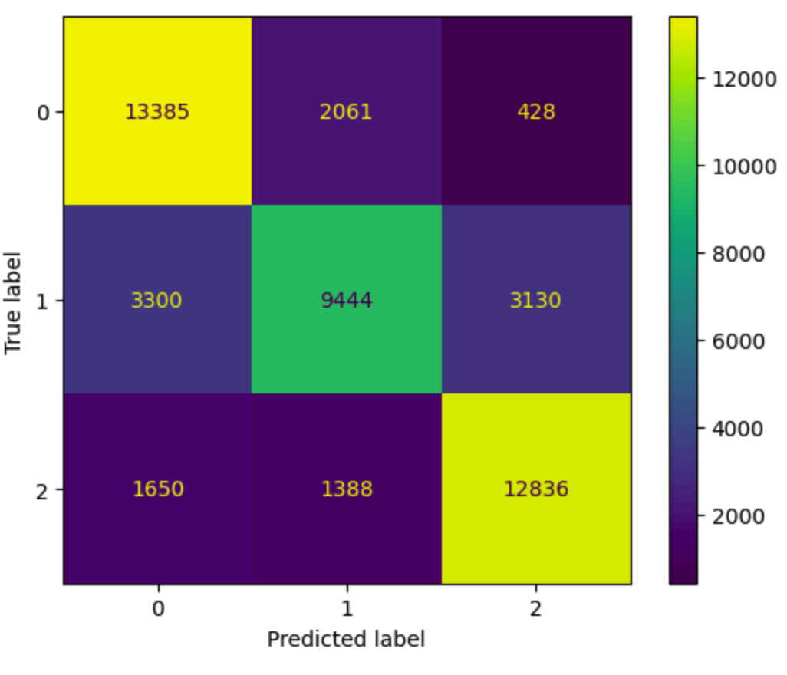
Supervised Comparison: Random Forest
Tuning (>90 Min)
Build Classifier (<1 Min)
Predict Training Set:
Results ~75% Accuracy (<1 Min)
https://www.kaggle.com/code/toddgardiner/unsupervised-final-creditscoring/

Slide 26
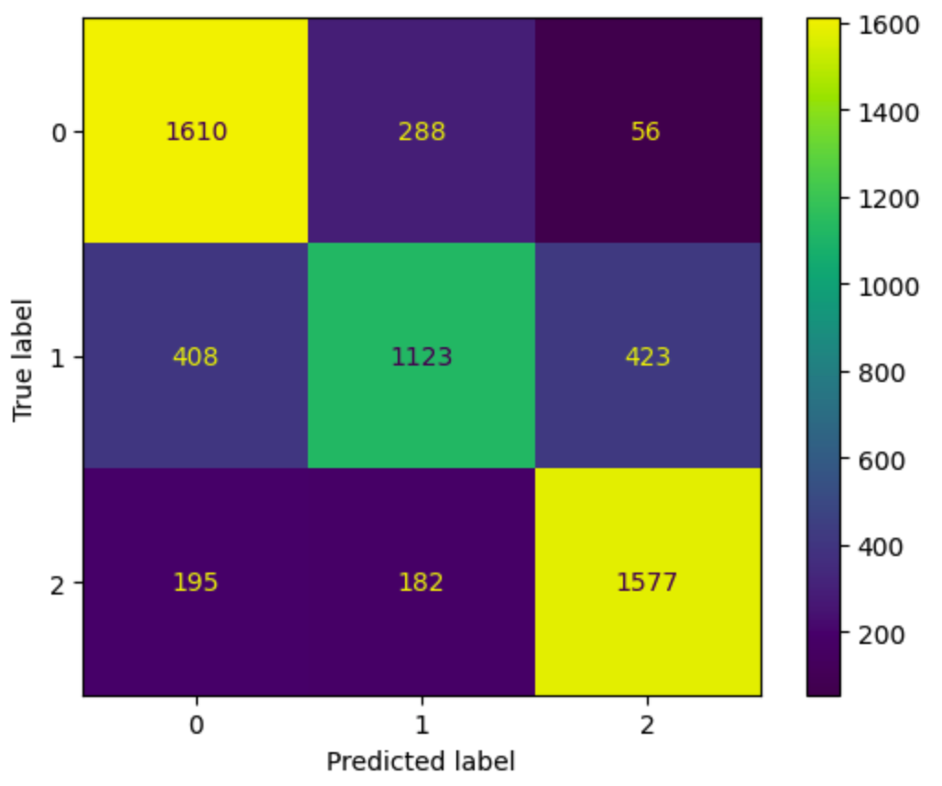
Supervised Comparison: Random Forest
Tuning (>90 Min)
Build Classifier (<1 Min)
Predict Training Set:
Results ~75% Accuracy (<1 Min)
Predict Testing Set:
Results ~74% Accuracy (<1 Min)
Model Loses 1.3% in Generalization
https://www.kaggle.com/code/toddgardiner/unsupervised-final-creditscoring/

Slide 27
Conclusion:
Clustering Algorithms are Capable Classifiers
KMeans 55% Accuracy, Agglomerative 53% Accuracy, Random Forest 74% Accuracy
Clustering Algorithms Have Different Prediction Capabilities
KMeans can make predictions on unseen Data (Affinity Propogation can too)
Agglomerative Clustering only works on seen Data (DBSCAN & HDBSCAN unable)
Clustering Algorithms are Fast to Set Up and Run
KMeans (< 1 Minute), Agglomerative (< 4 Minutes)
Random Forest Tuning and Implementation (> 90 Minutes)
https://www.kaggle.com/code/toddgardiner/unsupervised-final-creditscoring/

